Slide 1

Serverless Machine Learning Model Deployment with AWS SageMaker
GUDIPUDI LOHITH KUMAR-2210030223
Under the esteemed guidance of
Ms. P. Sree Lakshmi
Assistant Professor,
Department of Computer Science and Engineering

Slide 2
Project Overview
Manual deployment of ML models is time-consuming and infrastructure-heavy.
To build a machine learning model that predicts healthcare-related outcomes.
To integrate AWS services like Lambda and API Gateway for real-time inference.
Ensure secure, scalable, and low-maintenance model deployment.

Slide 3
Services Used
AWS SageMaker-Used to build, train, and deploy the machine learning model in a managed environment.
Amazon S3 (Simple Storage Service)-Used for storing the dataset, model artifacts, and logs securely and efficiently.
AWS Lambda- Enabled serverless execution of inference logic by invoking the deployed SageMaker model.
Amazon API Gateway-Provided a RESTful API interface to access the deployed model via HTTP requests.

Slide 4
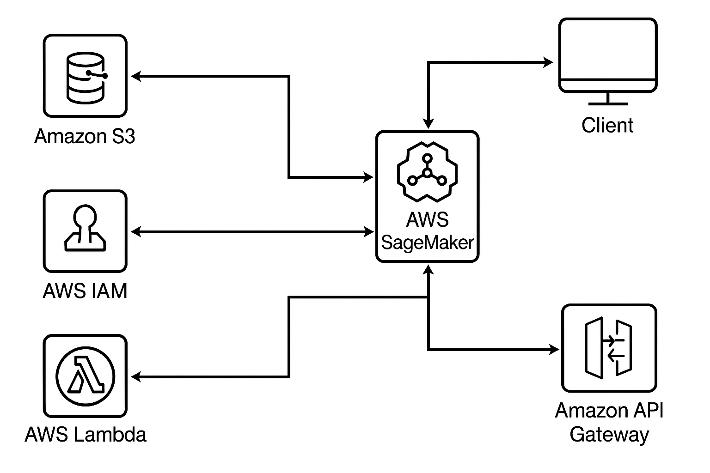
Flow Diagram

Slide 5
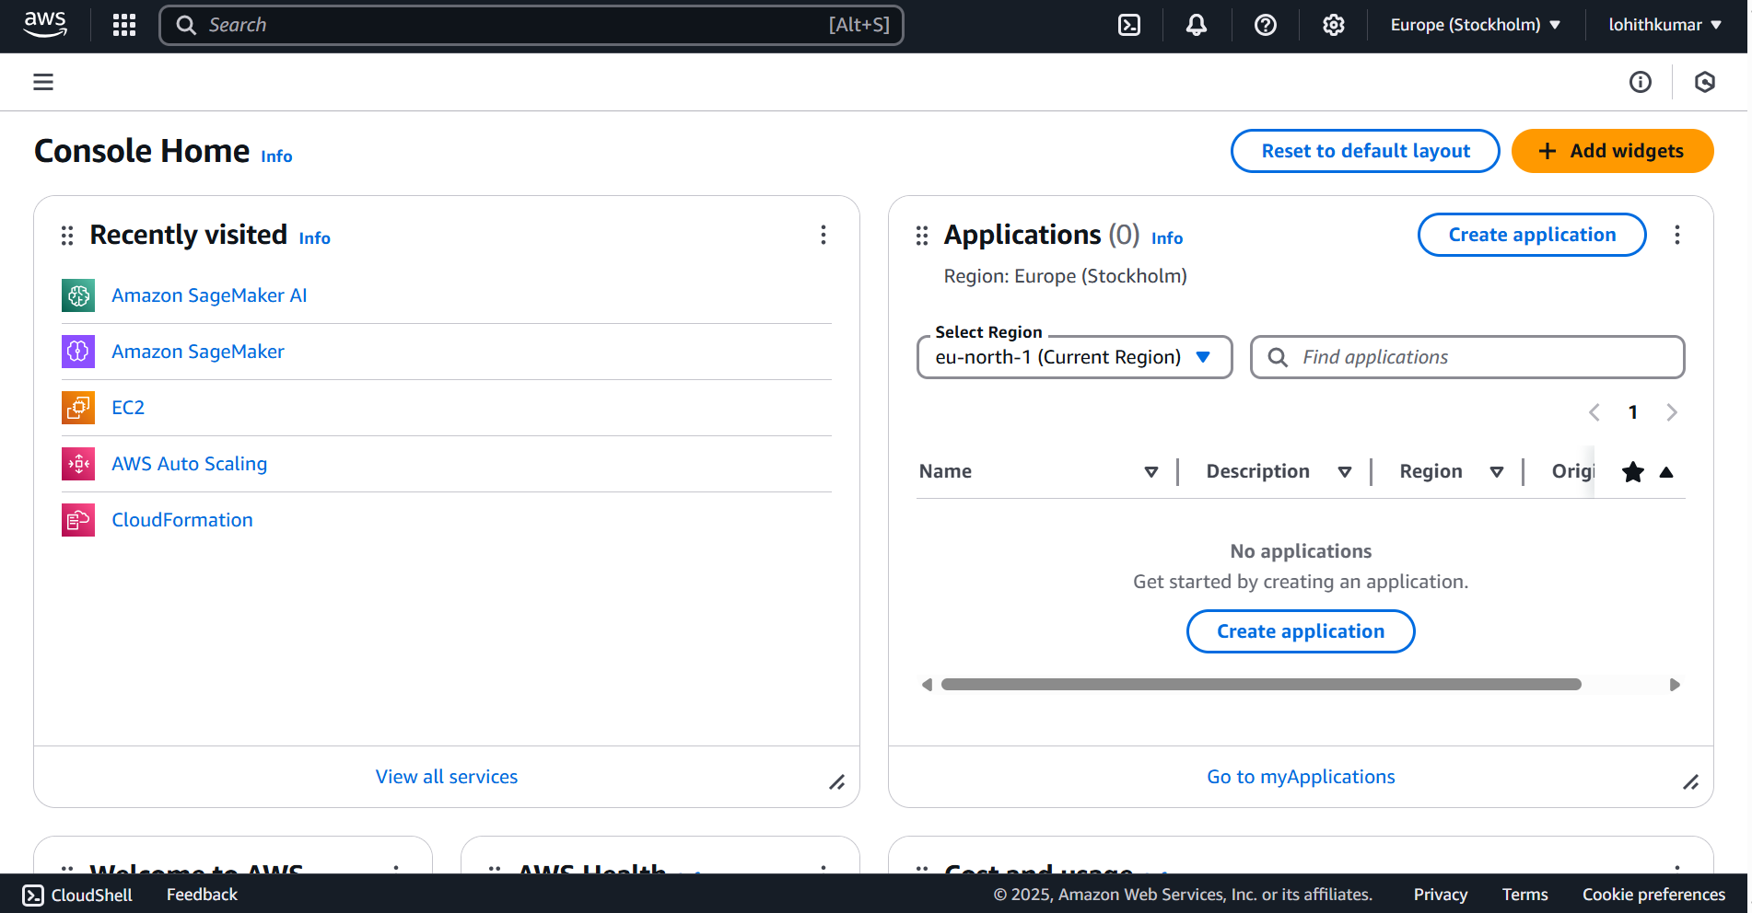
Implementation Process
Login to the AWS free tier account

Slide 6
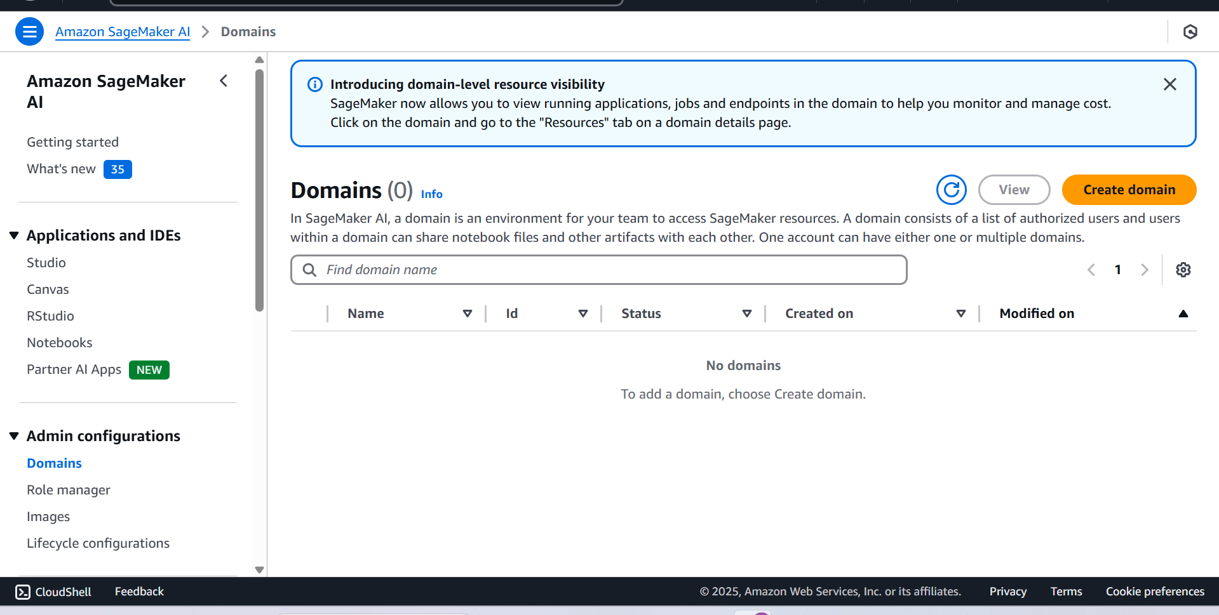
Search for the AMAZON SAGEMAKER AI

Slide 7
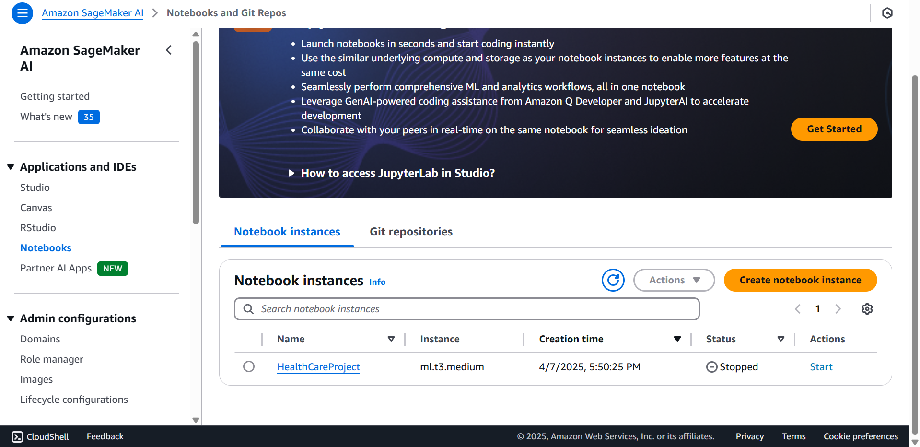
Create the notebook using the Sagemaker AI

Slide 8
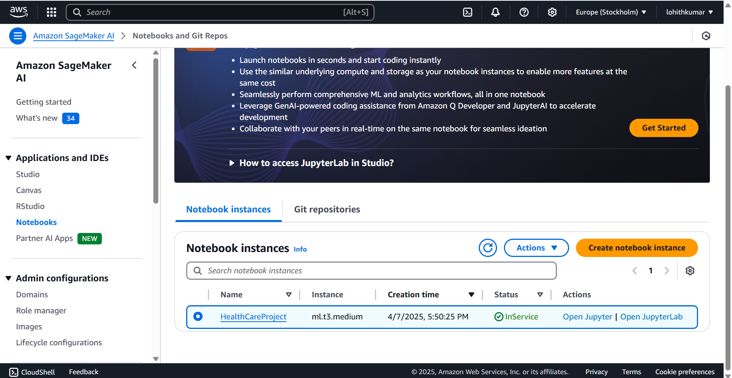
Start the Services and open Jupyter notebook

Slide 9
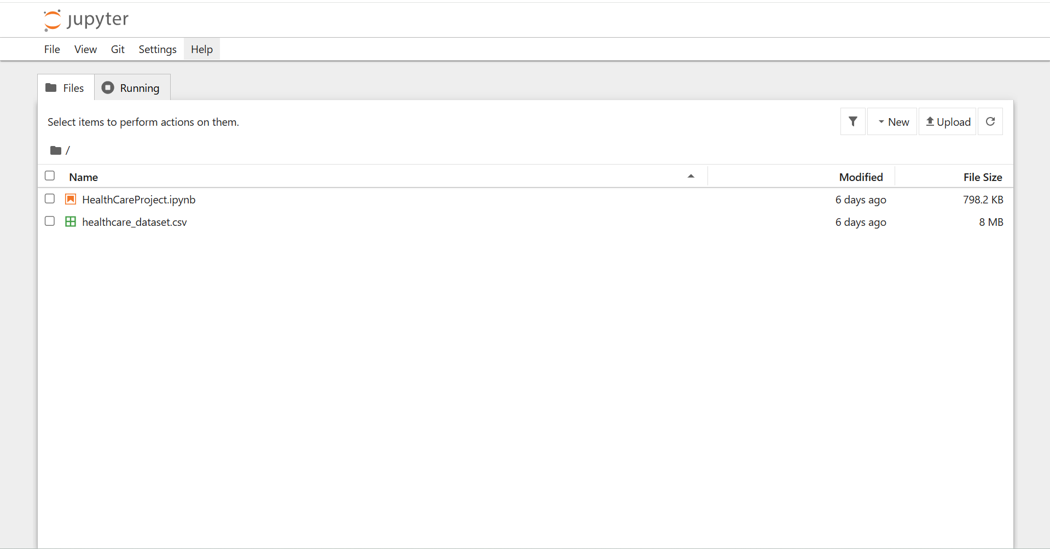
Take the csv file and ipynb file

Slide 10
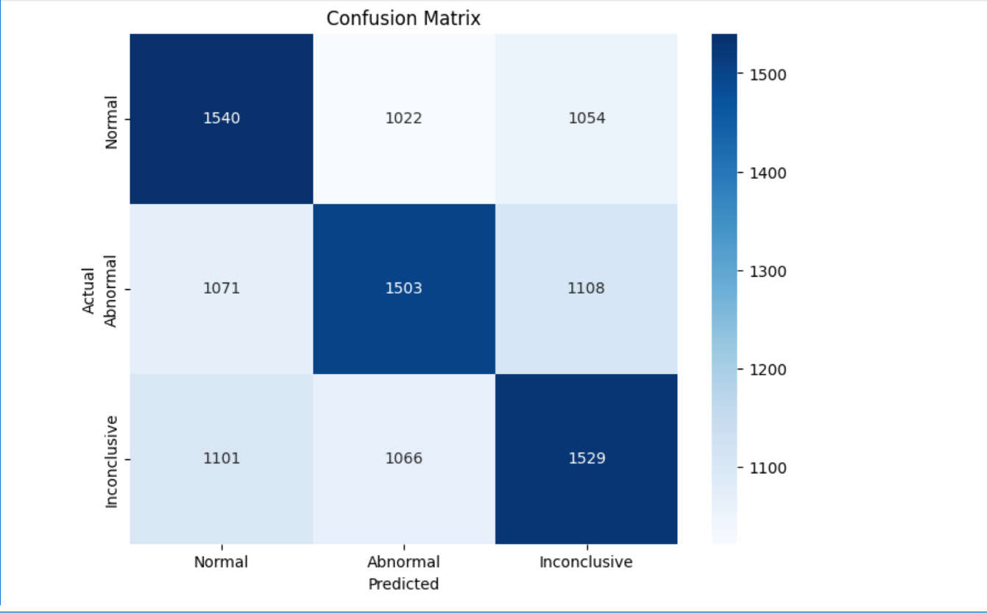
Final output of my project

Slide 11
Key Features and Functionality
Data preprocessing and feature engineering (scaling, encoding, cleaning)
Training a robust RandomForestClassifier with hyperparameter tuning.
Serverless deployment using AWS SageMaker and Lambda.
Real-time predictions through a REST API powered by API Gateway

Slide 12
End-User Perspective (UI/Output)
Seamless interaction via API — users can send input data and receive predictions.
Scalable backend ensures low latency and high availability.
Output: Predicted healthcare condition/classification result

Slide 13
Integration of Multiple AWS Services
.
Amazon S3: Data and model artifact storage.
AWS SageMaker: Model training and hosting
AWS Lambda: Serverless inference handler.
API Gateway: Public-facing endpoint for real-time access
IAM: Secure access and role-based permissions.
CloudWatch: Logs and monitoring of the deployed pipeline.

Slide 14
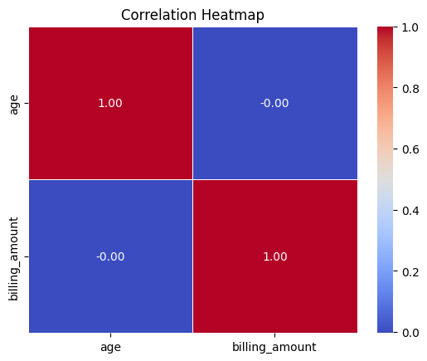
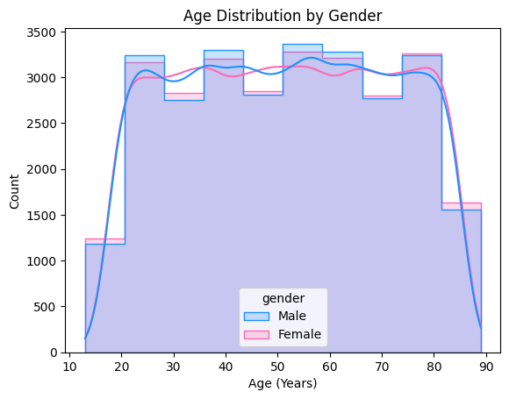
Results and Outputs

Slide 15
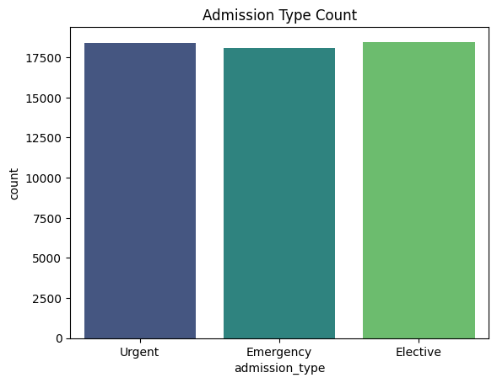
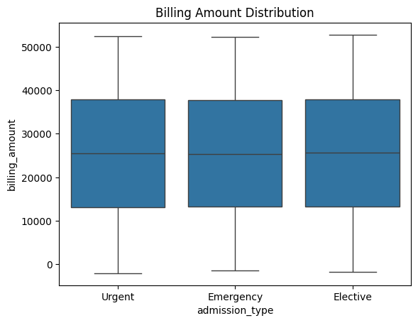

Slide 16
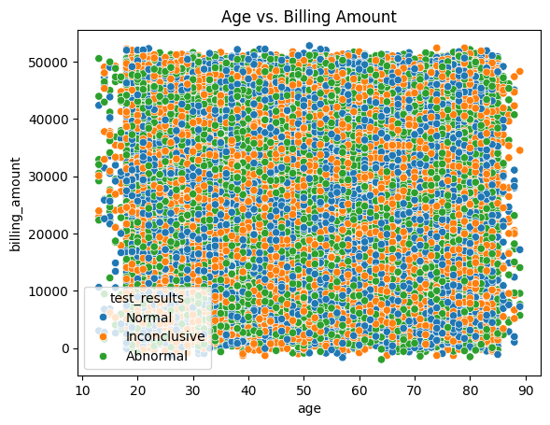
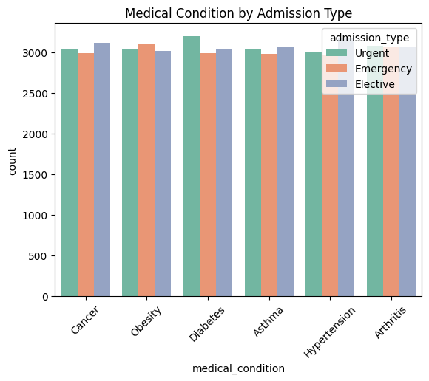

Slide 17
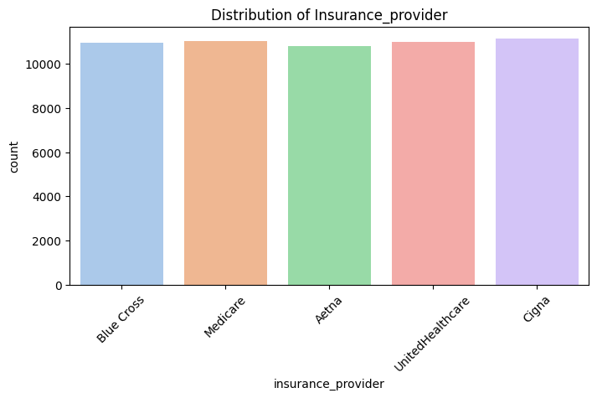
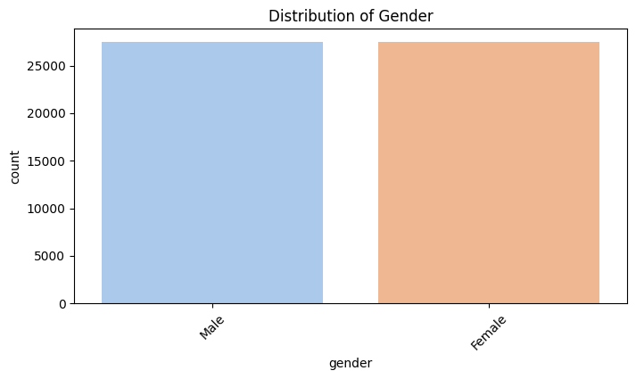

Slide 18
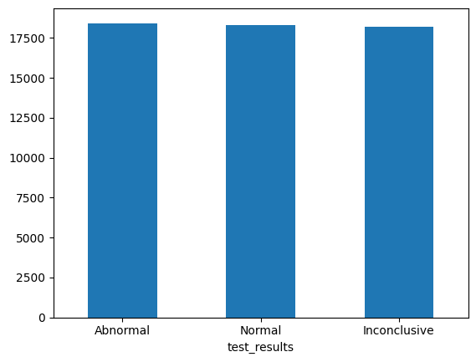
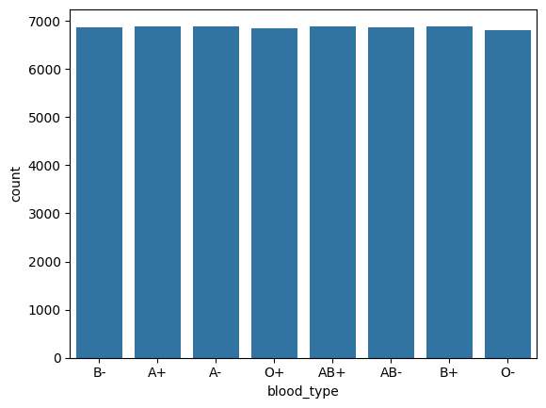

Slide 19
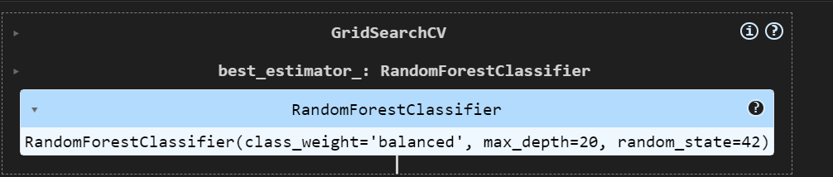
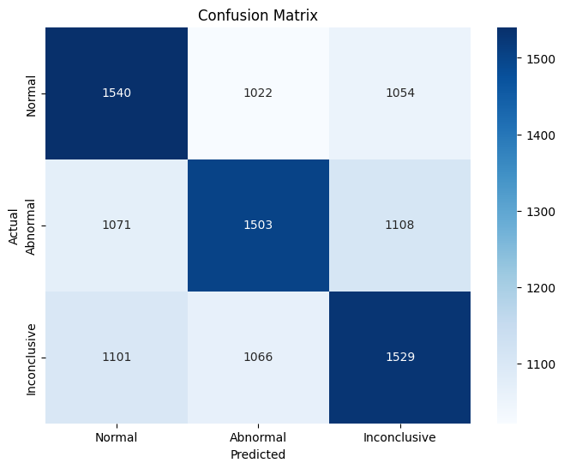

Slide 20
Challenges and Solutions
Integrating multiple AWS services with correct IAM roles and permissions.
Carefully configured IAM policies and used AWS documentation to map required roles and trust relationships
Utilized Amazon CloudWatch Logs to trace errors and monitor Lambda and SageMaker endpoint responses

Slide 21
Learnings & Takeaways
Gained hands-on experience with AWS IAM for managing secure access and role-based permissions
Learned to deploy and manage Lambda functions for serverless execution of ML inferences.
Understood the configuration and usage of Amazon API Gateway for exposing ML models as REST APIs
Strengthened ML model development skills including preprocessing, training, and evaluation.

Slide 22
Future Scope
Integrate a user-friendly frontend (web/mobile app) for healthcare professionals
Implement model retraining pipelines with updated data for continuous learning
Use advanced models like XGBoost or deep learning for improved accuracy

Slide 23
References
Healthcare Dataset(Kaggel)
Scikit-learn Documentation
Youtube
Chatgpt
Google

Slide 24
THANK YOU

